Slide 1

How many stars will my restaurant get???
ZOMATO RESTAURANT RATINGS
PREDICTION
Lohith G
Krishna Punyakoti

Slide 2
Executive Summary
Zomato is an Indian restaurant search and discovery service founded in 2008 by Deepinder Goyal and Pankaj Chaddah. It currently operates in 24 countries. It provides information and reviews on restaurants, including images of menus where the restaurant does not have its own website.
The restaurant search and discovery platform began its operations under the name, Foodie bay. In November 2010, the brand was renamed as Zomato.
In September 2012, Zomato expanded overseas to the United Arab Emirates, Sri Lanka, Qatar, the United Kingdom, the Philippines, and South Africa. In 2013, the company launched in New Zealand, Turkey, Brazil and Indonesia with its website and apps available in Turkish, Brazilian Portuguese, Indonesian and English.
Zomato narrowed down its losses by 34% to ₹389 Cr for the financial year 2016-17, from Rs 590.1 Cr crore in the previous year 2015-16
On 10 December 2018, a video went viral which showed a food deliverer eating directly out of the orders he had to deliver. In the video, the person can be seen repacking the food after eating it. The company said it was a "rare" incident and it will launch measures to prevent that from happening again.

Slide 3
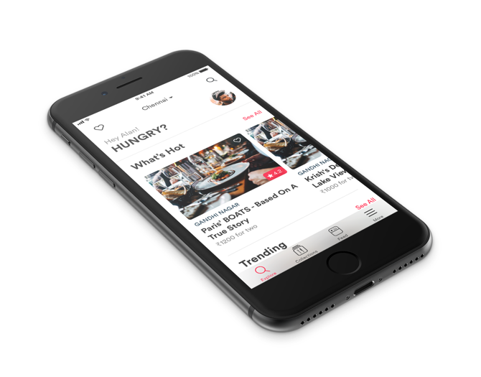
Project Summary
Zomato restaurant ratings prediction will be very useful for Zomato to mull the market strategies for on-boarding restaurants and provide better suggestions to food lovers on the new joints that they may want to try.
By knowing the predicted rating for newly on-boarded restaurants, Zomato can also help those restaurants which may possibly fall below the average ratings. It can also send updates to its users on the great-to-be restaurants near them.
The solution will be a true value add not only for Zomato business but also helpful for the restaurants and improved experience for its users/ food lovers.
With exploratory data analysis, this project also discovers and uncovers what
are the most essential factors to consider for a restaurant to be rated high.

Slide 4
Solution Approach
We followed a four step approach to our solution:
Data Gathering
Exploratory
Data Analysis
Data Pre-Processing
Machine
Learning
Data Gathering – The source of the datasets will be downloaded from APIs.
Data Collection: Data collected can be seen as a raw .json file here
Data Storage: The collected data has been stored in the Comma Separated Value file Zomato.csv. Each restaurant in the dataset is uniquely identified by its Restaurant Id.
EDA – Data Wrangling and EDA will be done to understand the data distribution, to get a preliminary idea on each of my data columns. This would help us in carrying out the required treatment on the features.
Data Pre-Processing– We will address the issues in our dataset by doing feature engineering, treating categorical columns and scaling numerical columns as required. We may also want to drop obviously insignificant columns.
Machine Learning – This is a regression problem that we have at hand. We will train different base regression algorithms on transformed train dataset. We will evaluate our base models and based on the output matrix we will tune our models using cross validation and GridSearchCV methods. The best estimators will then be used to predict the dependant variable on the transformed test dataset.

Slide 5
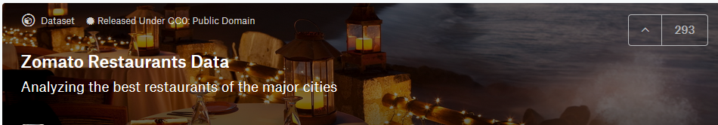
Data Gathering
Zomato restaurants data was gathered from the json files available on kaggle
The collected data has been stored in the Comma Separated Value file Zomato.csv. Each restaurant in the dataset is uniquely identified by its Restaurant Id.
This dataset ~24,000+ observations with 39 features providing restaurant details like cuisines, geographical columns and other special attributes of the restaurants.

Slide 6
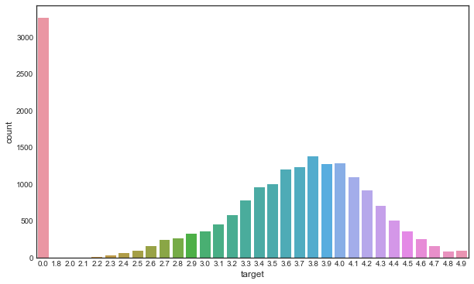
EDA: Dependent Variable
Dependent variable: Since the objective of our project is to predict Zomato restaurant rating, so ‘zomato_user_rating’ is our dependant variable.
By plotting the value counts of our dependant variable, we can understand the distribution in train set.
As we see, there are many "Not Rated" restaurants which are by default rated at ZERO. Otherwise, this looks like a perfect normal distribution.

Slide 7

EDA: Find Obviously Insignificant columns
We will drop columns based on these rules:
Highest Missing values
We will drop the columns with more than 70% NULL values.
Duplicate Columns
We have observed that there are columns that has aliases, for eg ‘location__city_id’ and ‘location__city_name’ are redundant. Hence we will drop one of these.
All Unique values
Columns such as restaurant_id, name are not useful in prediction. We will drop the columns that are of this nature.
Highest Percent of Single dominating category.
Features with only single values or highest percent of sing categorical label may not be helpful in this case. For eg: A column with all values as TRUE is of no use.

Slide 8
EDA: Find Obviously Insignificant columns
Columns with highest MISSING VALUES | Duplicate columns | Almost all are UNIQUE categories
'user_rating__rating_tool_tip', 'user_rating__custom_rating_text_background’, 'user_rating custom_rating_text’, 'medio_provider', ‘ zomato_events’, 'book_url', 'location__zipcode' | ‘establishment_types__establishment_type__name’, ‘location__city_id’, ‘featured_image’, ‘location__locality’, ‘location__locality_verbose’ | ‘id’, ‘name’, ‘location__latitude’, ‘location__longitude’,
Drop columns with highest Single dominating categories
include_bogo_offers has 100% values as TRUE. is_book_form_web_view has greater than 90% values as zeros and rest are blanks. is_table_reservation_supported has greater than 95% values as zeros. is_zomato_book_res has greater than 95% values as zeros and the rest 5% are ones or blanks. mezzo_provider has greater than 95% values as OTHER. opentable_support has 99% values as zeros and rest are blank. switch_to_order_menu has all zeros
From EDA, we see that all of the above columns are having similar values with more than 90% values as zeros. Hence, we will drop the above columns as they are insignificant for our prediction.

Slide 9
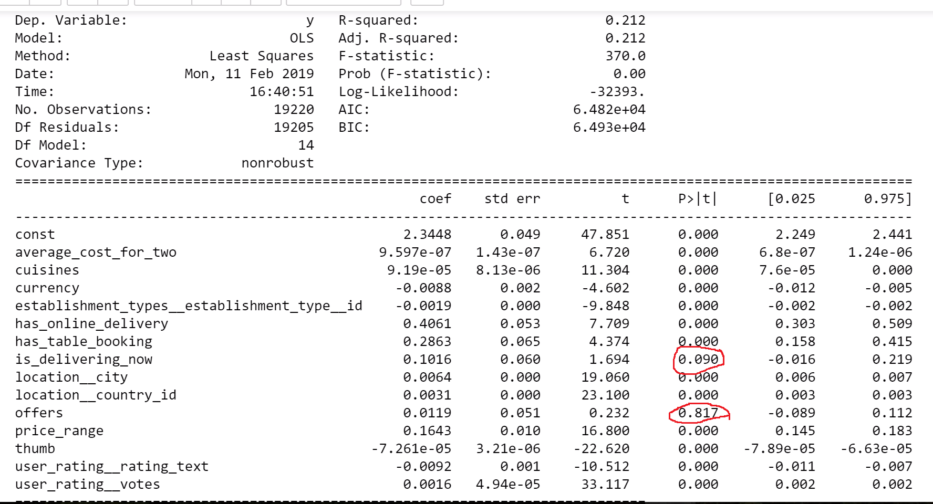
EDA: Find Insignificant columns using StatsModel
Offers and is_delivering_now columns are proven to be statistically insignificant by stats model OLS. Hence we will drop these two columns too.

Slide 10
Significant Features
From GradientBoosting GridSearchCV, we have selected the top 10 contributing features:
user_rating__votes
user_raing__rating_text
average_cost_for_two
thumb
cuisines
currency
location__country_id
location__city
establishment_types__establishment_type__id
price_range
has_online_delivery
has_table_booking

Slide 11
Data Pre-Processing
Feature Engineering:
User_rating_rating_text:The column is very significant column for our prediction as it resembles a high correlation to our dependant variable but the problem is that we have rating in various languages it would be very difficult if we treat them as it is ,so we are converting all the values in this column to six distinct values such as Excellent, Very good, Good, Above Average, Average and Poor.
Currency &average_cost_for_two:The column currency contains currencies of different country if we used them as it is there is chance of misinterpretation so we are converting all the values to $’s (USD) for standardization and also we are using this transformed value for the average_cost_for_two column.
Cuisines: In the column cuisines every field has many values also if we consider all values then its insignificant so to avoid this we are considering only first value from each field in the cuisines column.
Treating categorical columns:
Besides average_cost_for_two and user_rating__votes all other columns are categorical one. We are treating the categorical features by doing label encoding to get the feature importance.
Treating numerical columns:
Feature Scaling will be done using Standard scaler on ‘average_cost_for_two’ and ‘user_rating__votes’

Slide 12

Machine Learning Methodology
Baseline models: To understand the baseline evaluation metrics(RMSE and R2 score), we will train the following set of models on our training data set.
GradientBoostingRegressor
RidgeCV
XGBRegressor
Base Evaluation Metrics:
XGB Train RMSE: 0.023430404303711492
Gradient Boosting Train RMSE: 0.023300998612278072
RidgeCV Train RMSE: 0.025381722061938804
From the base evaluation metrics we understood that our models are overfitting the train data. We will use cross validation and bootstrapping techniques to train our models and compare the performance of the all models.
We have selected few linear models, free tree based models and few ensemble methods for comparison.

Slide 13
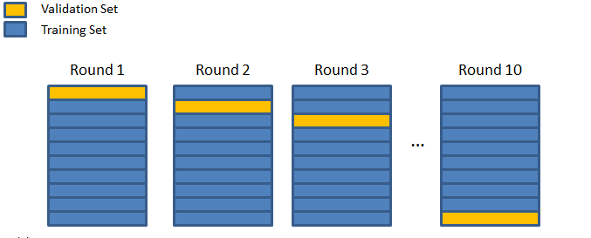
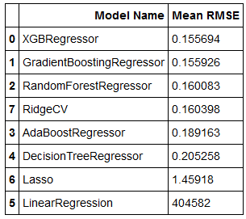
Cross Validation
By using cross_val_score, we have trained our models on 10 folds. We have also used some more models to compare the performance of different models to pick the best performing models.
From the cross validation output scores, we see that we have overcome the overfitting problem.

Slide 14
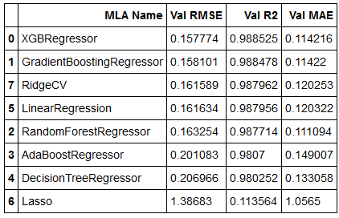
Bootstrapping
This time, we have used Bootstrapping resampling technique to train the models. We have used the same set of models to see if they are consistently performing well or not.
We will pick these two models for further tuning.
Based on CrossValidation and bootstrapping model evaluation metrics, we can conclude that XGBRegressor and GradientBoostingRegressor have performed consistently better than others.

Slide 15

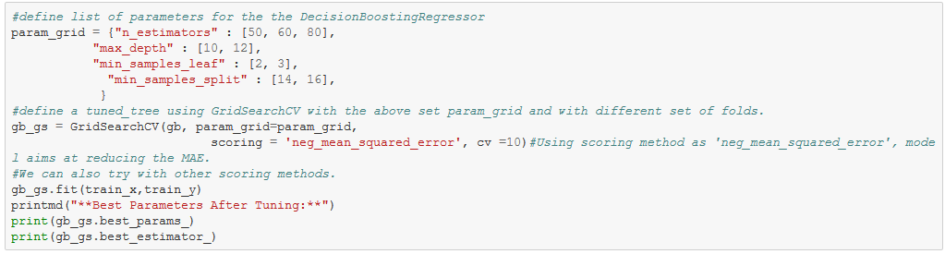
Parameter Tuning - GridSearchCV
Now we will tune these models using GridSearchCV to get the best set of Hyperparameters
Tuning GradientBoosing
Best Parameters After Tuning:
{'max_depth': 10, 'min_samples_leaf': 3, 'min_samples_split': 16, 'n_estimators': 60}

Slide 16
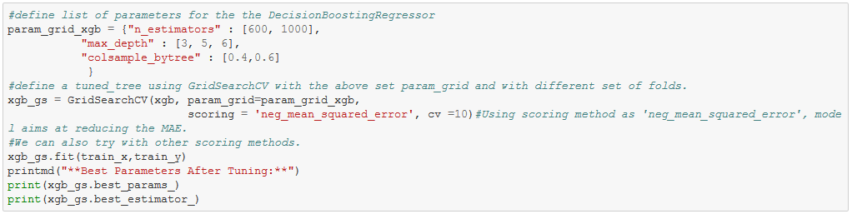
Tuning of the Model - GridSearchCV
Tuning XGBRegressor
The above is the code for tuning of the model where we are using XGBRegressor with GridSearchCV to get best parameters after tuning
Best Parameters After Tuning:
{'colsample_bytree': 0.6, 'max_depth': 5, 'n_estimators': 600}

Slide 17
Finalize the Model
Tuning these models took considerably lot of time as we have tried multiple parameters with different settings and ran these for 10 Folds.
To avoid computational costs we can reduce the folds or parameter settings and if computational cost is not an issue, then we can try more parameter settings.
Next we finalized the best estimators to predict on test dataset.
gb_gs.best_estimator_
GradientBoostingRegressor(alpha=0.9, criterion='friedman_mse', init=None, learning_rate=0.1, loss='ls', max_depth=10, max_features=None, max_leaf_nodes=None, min_impurity_decrease=0.0, min_impurity_split=None, min_samples_leaf=3, min_samples_split=16, min_weight_fraction_leaf=0.0, n_estimators=60, n_iter_no_change=None, presort='auto', random_state=None, subsample=1.0, tol=0.0001, validation_fraction=0.1, verbose=0, warm_start=False)
xgb_gs.best_estimator_
XGBRegressor(base_score=0.5, booster='gbtree', colsample_bylevel=1, colsample_bytree=0.6, gamma=0, learning_rate=0.1, max_delta_step=0, max_depth=5, min_child_weight=1, missing=None, n_estimators=600, n_jobs=1, nthread=None, objective='reg:linear', random_state=0, reg_alpha=0, reg_lambda=1, scale_pos_weight=1, seed=None, silent=True, subsample=1)

Slide 18
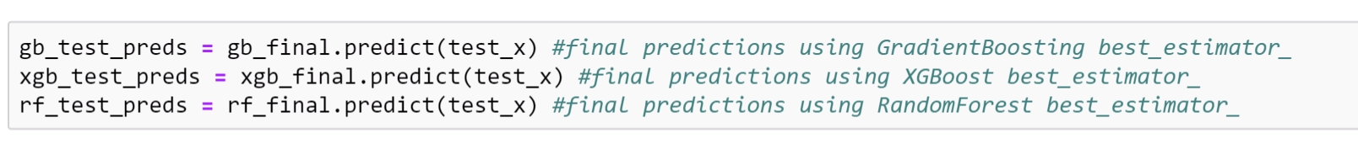
Final Predictions
Using the best estimators, we will predict on the test dataset.
However, we need to treat the numerical columns in test data set in the same way as we did on train set
For this, we will apply the StandardScaler transform method which we have fitted on the train set.

Slide 19
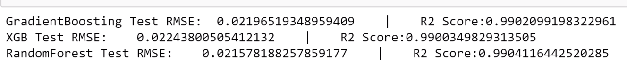
Evaluation of the Model
Below are the calculated RMSE,R2 score for XGB, GradientBoosting and RandomForest.
Inferences :
From Test RMSE scores, we see that all models have performed really well on unseen data with minimal errors. With test R2 Squared value standing at 0.99, we can infer that our models have fitted the data very closely. This also, implies that best_estimators have performed really great after hyperparameter tuning. Though, the error difference between the models are very less, we can consider Random Forest and GradientBoosting for further tweaking as their RMSE is comparatively better. Also, one more intersting observation is that the RandomForest which has more error during cross validation(0.160(rf) vs 0.155(gb)) performed little better than other models, after hyperparameter tuning. Hence, it would be worthy tweaking more parameters using RandomForest and so we can use rf_final as our final model.
There could be many other possible and innovative ways to make these models better. We will explore further options and will continue our learning...

Slide 20

Thank You
so, how many stars will
my restaurant get?
well, that depends on
your product :P

Slide 21
Appendix

Slide 22
References
ML modelling, project flow, Tips and Best Practices -
UC ML videos and workshops
Hands on Machine Learning using Scikit Learn and Tensor flow book by Aurelien Geron.
Jupyter notebook editing tips
https://medium.com/ibm-data-science-experience/markdown-for-jupyter-notebooks-cheatsheet-386c05aeebed
Project Insights
https://rstudio-pubs-static.s3.amazonaws.com/296592_29cd90970f7f4e18958a215416803927.html
https://www.kaggle.com/lorenzopagliaro01/zomato-restaurants-analysis
https://www.analyticsindiamag.com/the-amazing-way-zomato-uses-data-science-for-success/

Slide 23





Technology Involved

Slide 24
Data Dictionary
id: Unique id of every restaurant across various cities of the world
average_cost_for_two: Cost for two people in different currencies
book_url: The url from where the booking was done
cuisines: Cuisines offered by the restaurant
currency: Currency of the country
establishment_types__establishment_type__id: The id of the type of restaurant
establishment_types__establishment_type__name: The type of the restaurant whether it is a Café, Casual Dining, Bar etc
has_online_delivery: The restaurant has online delivery (yes =1/ no =0)
has_table_booking: Is table booking facility available in the restaurant(yes=1/no =0)
include_bogo_offers: Does the particular restaurant include bogo offers TRUE/FALSE
Is_booking_from_web_view: Is the booking done from web view
Is_delivering_now: Is the restaurant delivering now ( yes=1/ no=0)
is_table_reservation_supported: The table reservation is supported by the particular restaurant or not (yes=1/no=0)
is_zomato_book_res: Is the Zomato booking reservation available (yes =1/no=0)
Location_Address: Address of the restaurant
location__city: City in which restaurant is located
location__city_id: The id of the city in which restaurant is located
location__country_id: The country code in which restaurant is located

Slide 25
Data Dictionary
location__latitude: Latitude coordinate of the restaurant's location
location__locality: Location in the city
location__locality_verbose: Detailed description of the locality
location__longitude: Longitude coordinate of the restaurant's location
location__zipcode: Zipcode of the location
name: Name of the restaurant
offers: The offers available for the restaurant
opentable_support: Is opentable support available for the restaurant
price_range: range of price of food
Switch_to_order_menu: yes/no
user_rating__custom_rating_text: Whether it is a new restaurant or old one
user_rating__custom_rating_text_background:
user_rating__rating_text: Text on the basis of user rating
user_rating__rating_tool_tip: this is a note section about the restaurant
user_rating__votes: : Number of ratings casted by people
zomato_events: Events organized by Zomato
Zomato_user_rating: Categorizing ratings between 1-5

Slide 26
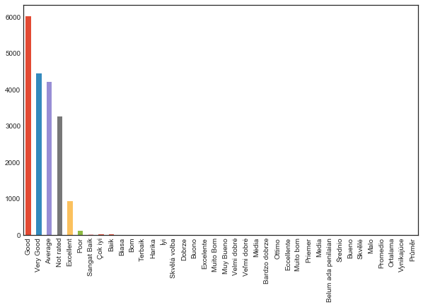
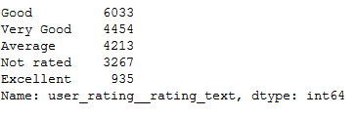
‘user_rating__rating_text’ value count distribution

Slide 27
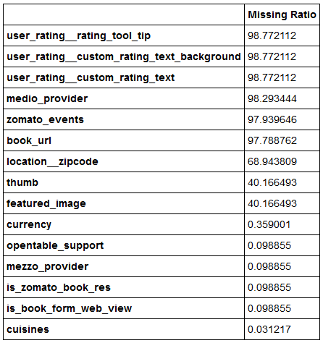
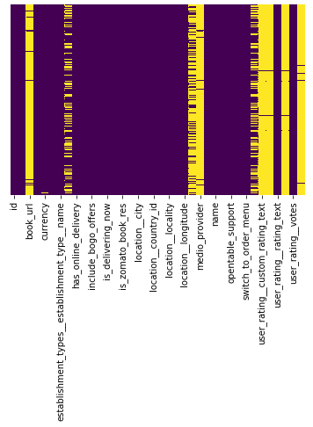
Missing values ratio

Slide 28
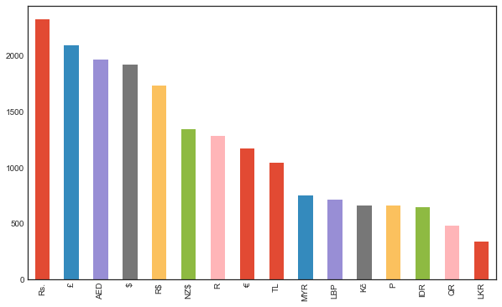
Multiple Currencies Distribution

Slide 29
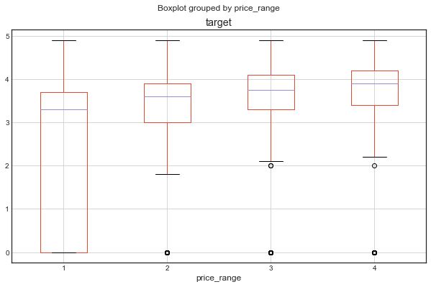
price_range to user_rating relation

